Slide 1
Classify gestures by reading muscle activity Iman Fekri and Mohammad Hossein Bayati

Slide 2
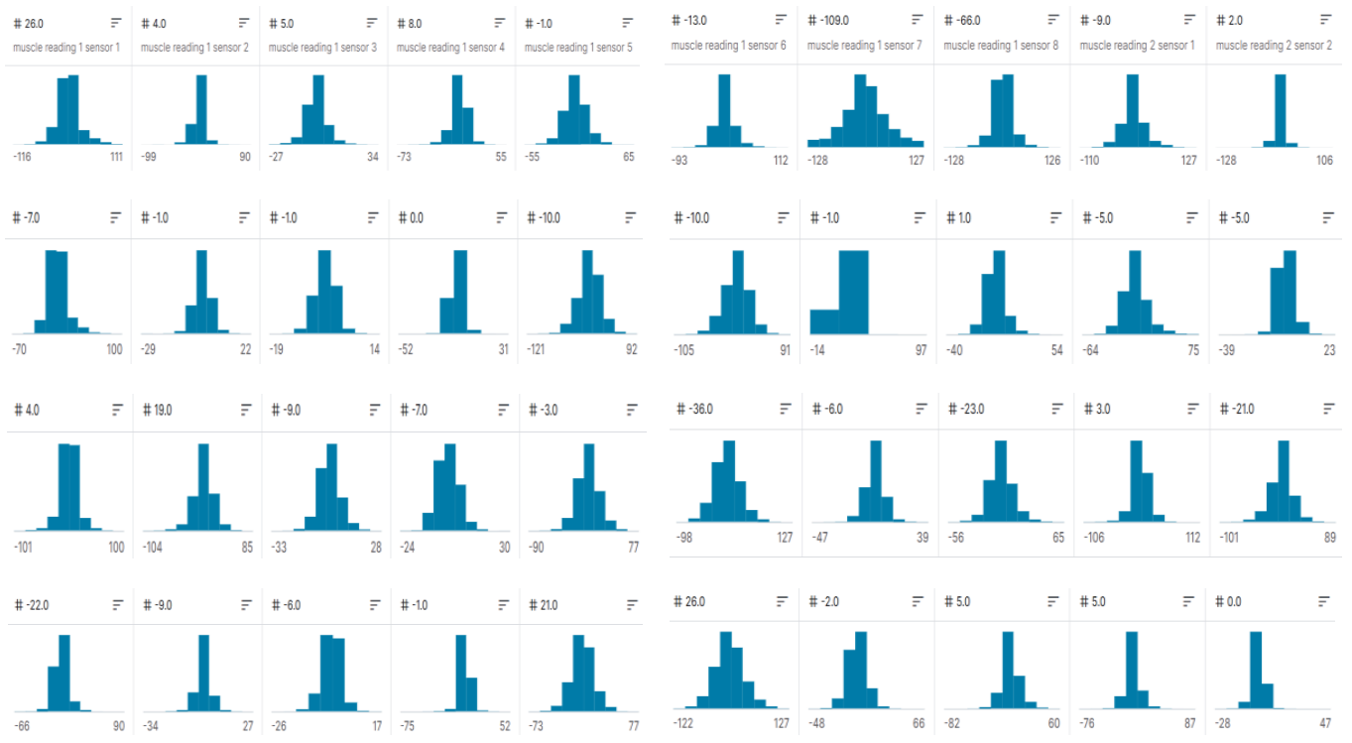
Data collected from the robot arm

Slide 3
Smart methods are used to check accuracy
recurrent neural network (RNN)
Random forest (RF)
Support Vector Classification (SVC)
Decision Tree
Multilayer perceptron (MLP)
Nearest neighbor (NN)

Slide 4
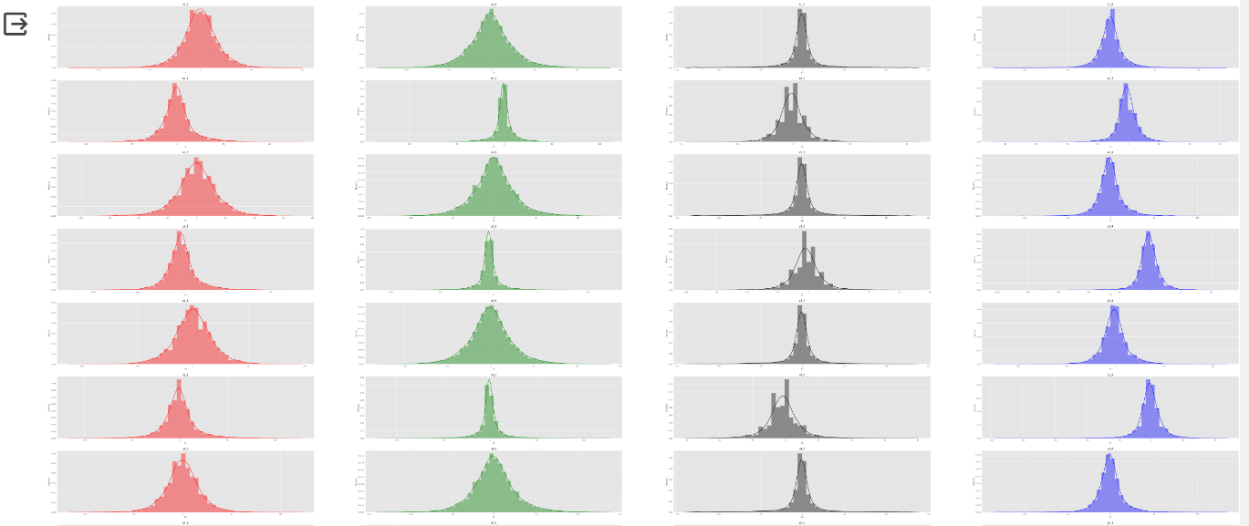
Data preprocessing methods
1) Data distribution
2) Data standardization
3) Shuffle data

Slide 5
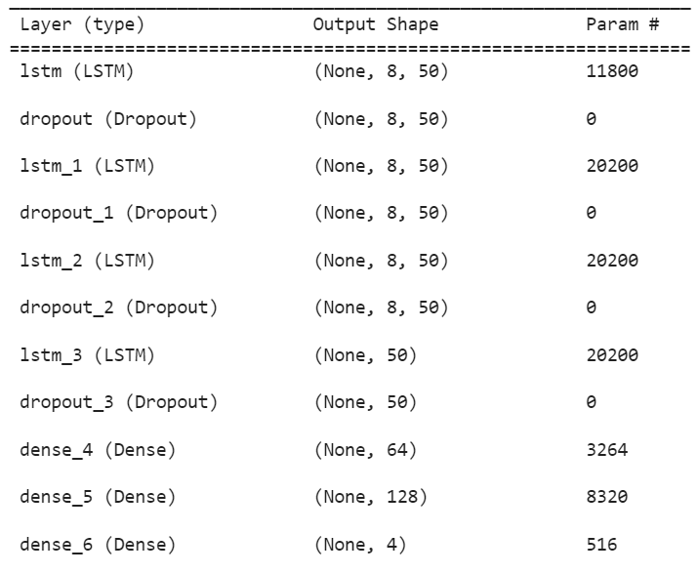
recurrent neural network (RNN)
model = Sequential()
model.add(LSTM(units=50, return_sequences=True, input_shape=(X_train.shape[1], 8)))
model.add(Dropout(0.2)) #dropout rate = 20%
model.add(LSTM(units = 50, return_sequences = True))
model.add(Dropout(0.2))
model.add(LSTM(units = 50, return_sequences = True))
model.add(Dropout(0.2))
model.add(LSTM(units = 50))
model.add(Dropout(0.2))
model.add(Dense(units = 64))
model.add(Dense(units = 128))
model.add(Dense(units = 4, activation="softmax")) #4 as the output classes
model.compile(optimizer = "adam" , loss = "categorical_crossentropy", metrics=["accuracy"])

Slide 6
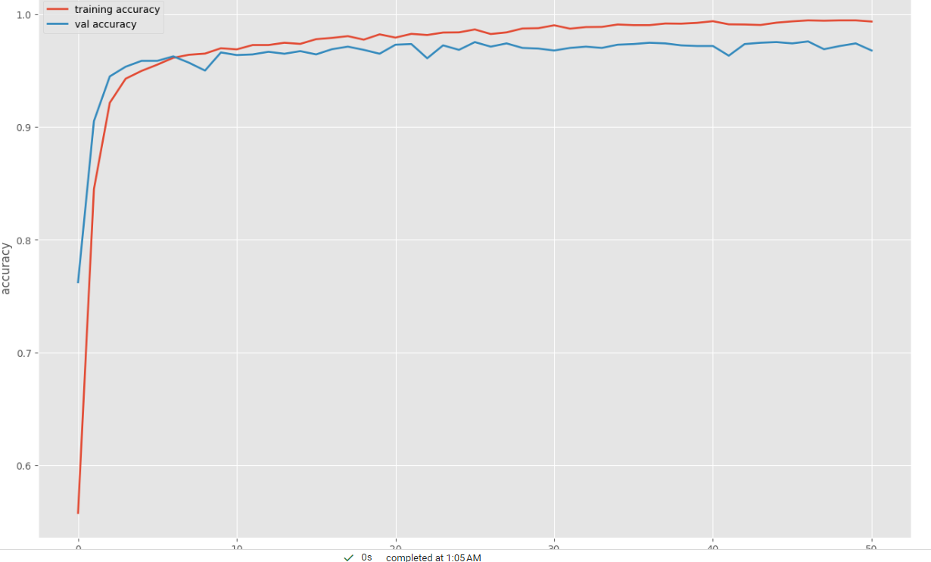
Display accuracy and loss graph

Slide 7
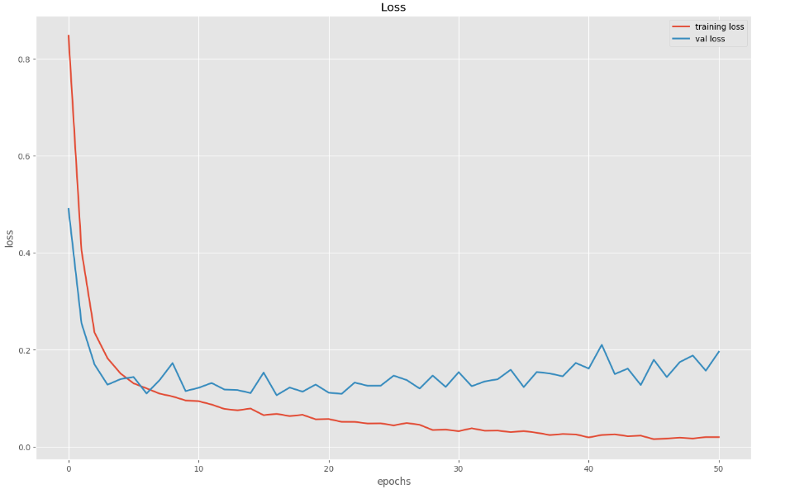
Display accuracy and loss graph

Slide 8
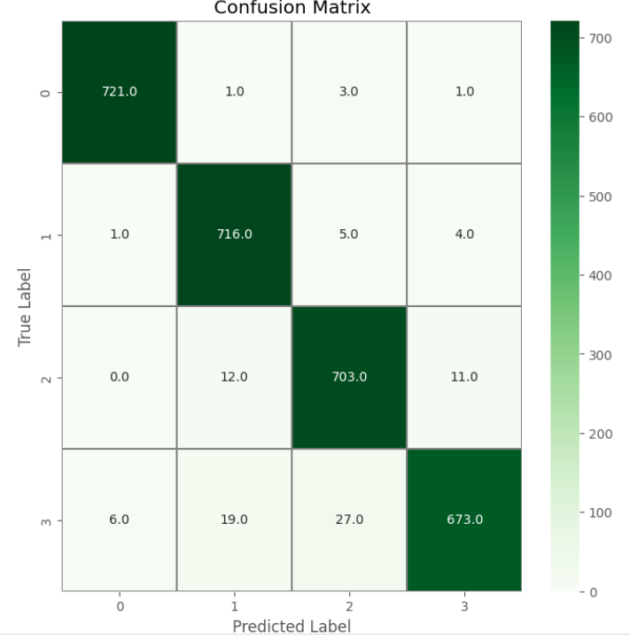
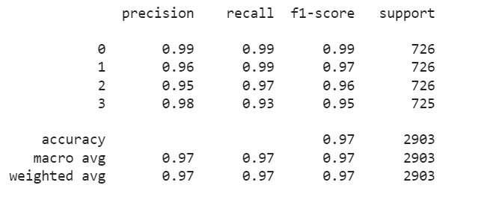
Show the confusion matrix and the final results

Slide 9

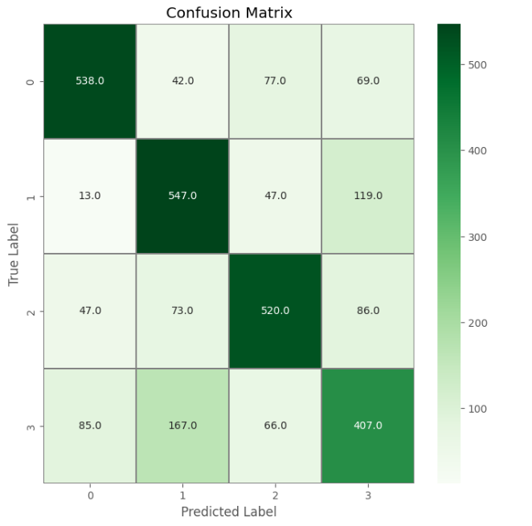
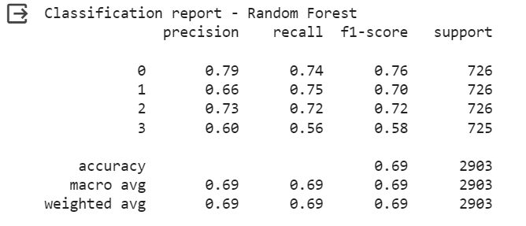
#fit of the classifier to the training data rf_model = RandomForestClassifier(n_estimators=100,random_state=93) rf_model.fit(X_train_rf, y_train_rf)

Slide 10

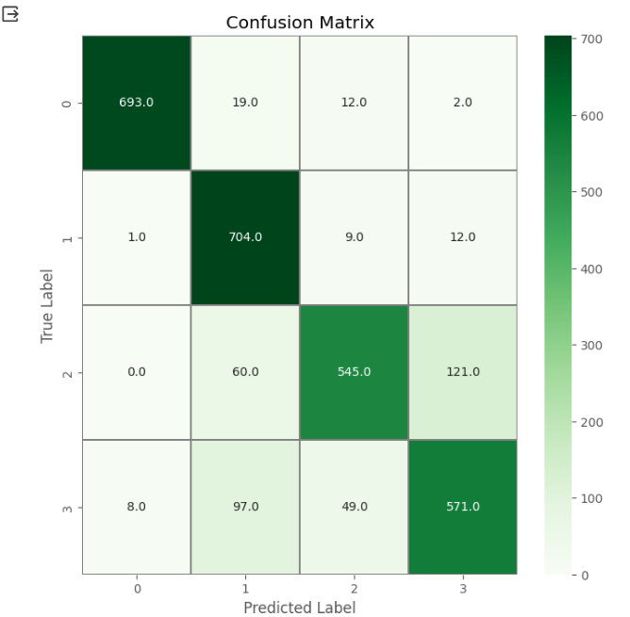
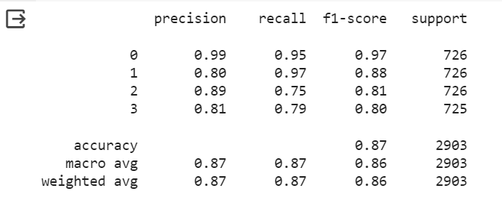
model = SVC(kernel = 'rbf',decision_function_shape='ovo') model.fit(X_train, y_train(

Slide 11
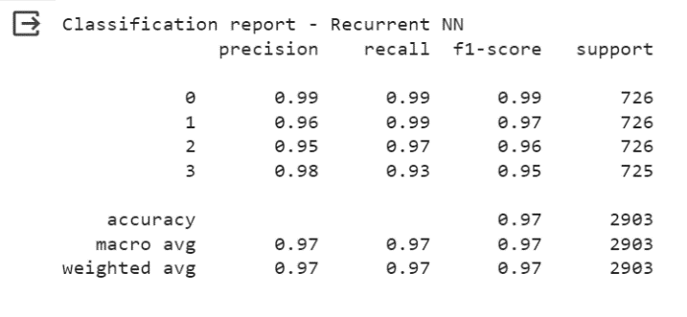
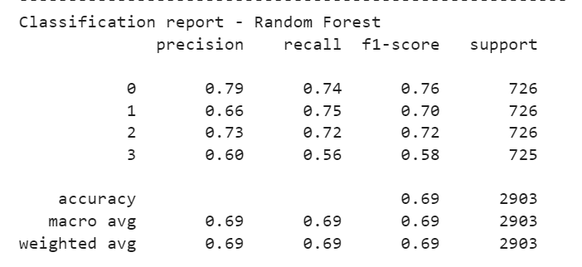
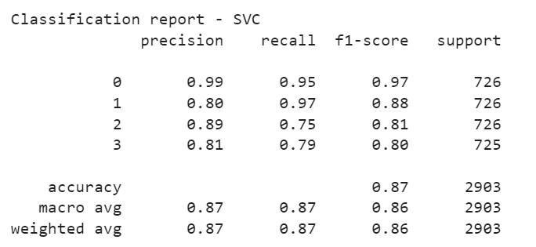
Comparison of four methods at a glance

Slide 12
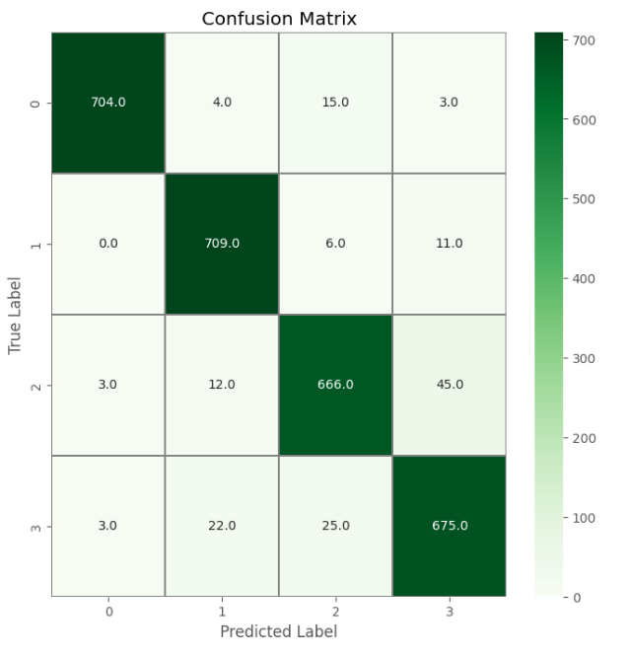

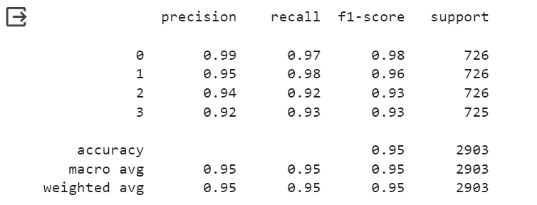
model = MLPClassifier(hidden_layer_sizes=(80,), activation='relu', solver='adam',
alpha=0.1,max_iter=100, shuffle=True, random_state=93)
model.fit(X_train, y_train)
model.score(X_test, y_test)

Slide 13


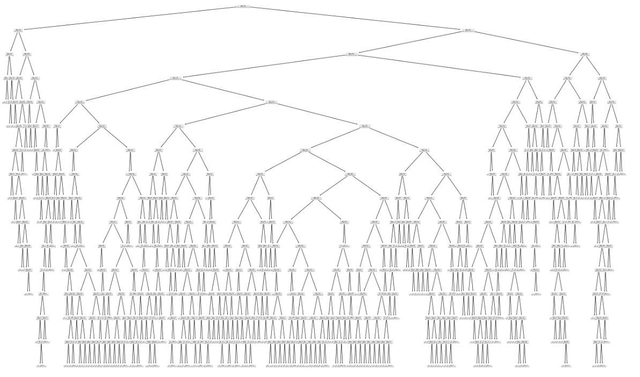
clf = tree.DecisionTreeClassifier(max_depth=18, random_state=42, ccp_alpha=0.001)
clf.fit(X_train, y_train)

Slide 14
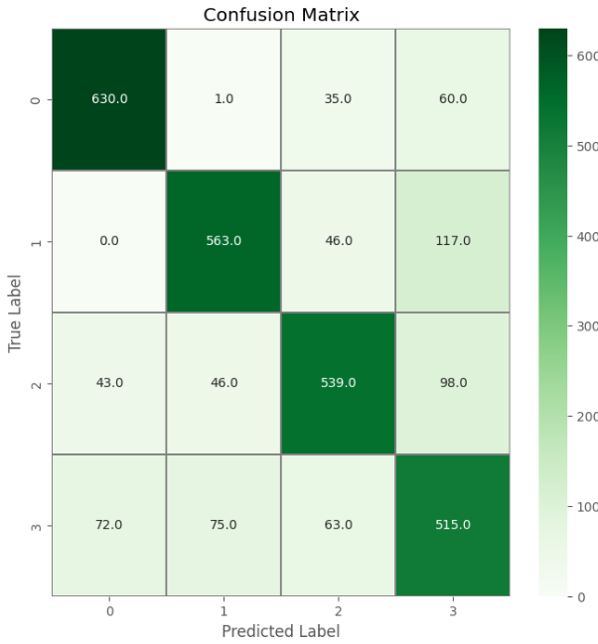
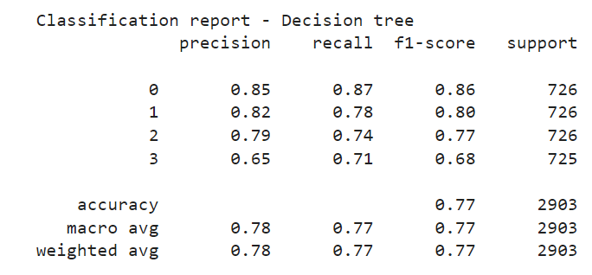
Show the confusion matrix and the final results

Slide 15

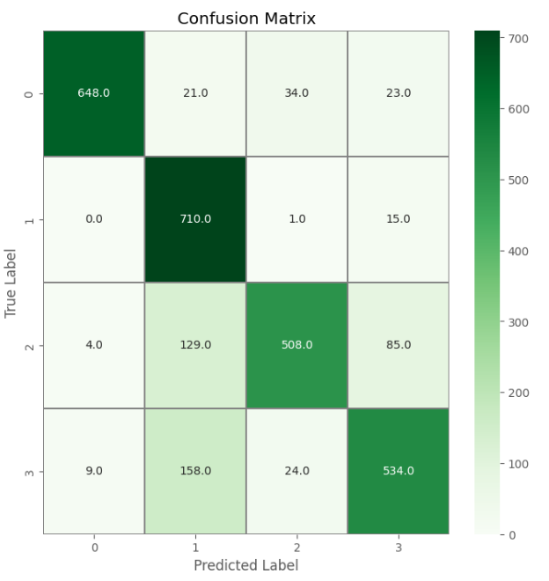
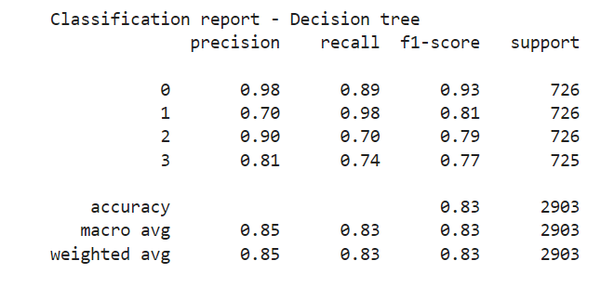
nca = NeighborhoodComponentsAnalysis(random_state=42) knn = KNeighborsClassifier(n_neighbors=4) nca_pipe = Pipeline([('nca', nca), ('knn', knn)]) nca_pipe.fit(X_train, y_train) print(nca_pipe.score(X_test, y_test))

Slide 16
Thank you for your attention

